Slide 1


Slide 2
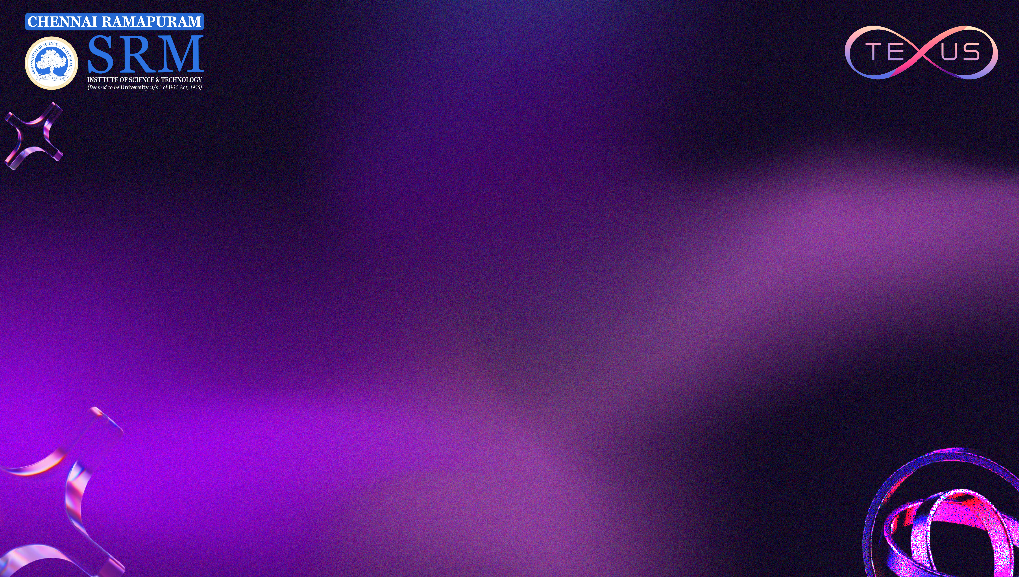
TEAM INTRODUCTION
Team Name: KNOX
College / Institution: srm institute of science and technology
Team Members: Aryan,Arjun,Balaji,Ronak
Track Chosen: Health Care

Slide 3
PROBLEM STATEMENT
Clearly define the problem:
>Imagine trying to walk through a busy corridor without being able to see what's ahead. Is that a door or a wall? Is someone walking toward you? Are there stairs coming up? For visually impaired people, every step requires this kind of mental calculation.
>White canes help detect ground-level obstacles, but they can't warn about things overhead, moving cars, or even tell you if that dark patch ahead is a doorway or just a shadow. Guide dogs are amazing but they're expensive, take years to train, and most people simply can't access them. Current smartphone apps mostly just say "chair detected" or "person detected" without actually helping you move safely—they tell you what's there, not what you should do about it.
>The real problem is that visually impaired people lack real-time situational awareness that helps them make quick navigation decisions confidently.

Slide 4
PROBLEM STATEMENT
Who faces this problem?:
This affects over 2.2 billion people worldwide with visual impairments—from students trying to navigate their college campus, to professionals commuting to work, to elderly people just trying to visit the doctor independently. It also impacts their families who constantly worry about their safety.
Why is it important or relevant?:
Mobility equals independence. When you can't navigate safely on your own, it affects everything—your education, job opportunities, social life, and mental health. Right now, unemployment among visually impaired people is disproportionately high, partly because they struggle with the basic act of getting places independently.
We have incredible AI technology today—it's time we use it to solve real human problems like this.

Slide 5
PROPOSED SOLUTION
Description of the solution:
>VisionPartner turns your smartphone into an intelligent navigation assistant. You hold your phone while walking, and it continuously watches the environment through the camera, understanding what's around you in real-time.
But here's the key difference: it doesn't just list objects. It acts like a co-pilot, telling you what matters for safe movement and giving you clear instructions.
Instead of: "Chair detected" It says: "Obstacle on your right—shift left"
Instead of: "Stairs detected" It says: "Steps down ahead in 2 meters—align center“
>We use Google's Gemini Vision API to understand scenes intelligently, combined with fast on-device detection for immediate obstacle awareness. The app guides you through both voice instructions and vibration patterns—left buzz means move left, rapid pulses mean danger, long buzz means stop.

Slide 6
PROPOSED SOLUTION
How it addresses the problem:
VisionPartner solves three critical gaps:
>Real context, not just labels: It understands that a car backing up is more urgent than a parked one. It knows when someone's crossing your path versus standing still.
>Actionable directions: Every alert tells you what to do—move left, slow down, stop—not just what exists. This reduces the mental work of figuring out your next move.
>Works anywhere: With both cloud AI and on-device detection, it functions even when internet is spotty. The core safety features work offline.

Slide 7
PROPOSED SOLUTION
What makes it innovative or unique:
>Most apps just identify objects and read them out. VisionPartner has a "navigation brain" that actually thinks about what you need.
>It prioritizes—a moving vehicle gets announced before a distant wall. It filters—you don't hear about every poster and sign. It guides—it tells you which direction to move, not just that something exists.
>The combination of smart scene understanding (Gemini Vision) and instant obstacle detection (on-device AI) means you get both intelligence and speed. Plus the dual feedback—audio and vibration—gives you options. In a noisy street, feel the vibrations. In a quiet library, rely on gentle audio.
Nobody else is combining these elements to create actual navigation intelligence

Slide 8
TARGET USERS & IMPACT
Who will use this solution?:
>Primary users: Blind and visually impaired people who need help navigating daily environments—streets, buildings, campuses, malls.
>Also helpful for: Elderly people with vision loss, anyone with temporary vision impairment, people with conditions like severe tunnel vision who miss peripheral obstacles.
>Organizations: Schools for the blind, rehabilitation centers, accessibility training programs can use this as a teaching tool.

Slide 9
TARGET USERS & IMPACT
What impact does it create?:
>Independence: People can walk to class, commute to work, meet friends without arranging assistance every time.
>Opportunities: Better mobility means better access to all services and other things around
>Dignity: Not having to constantly ask for help, being able to make spontaneous decisions to go

Slide 10
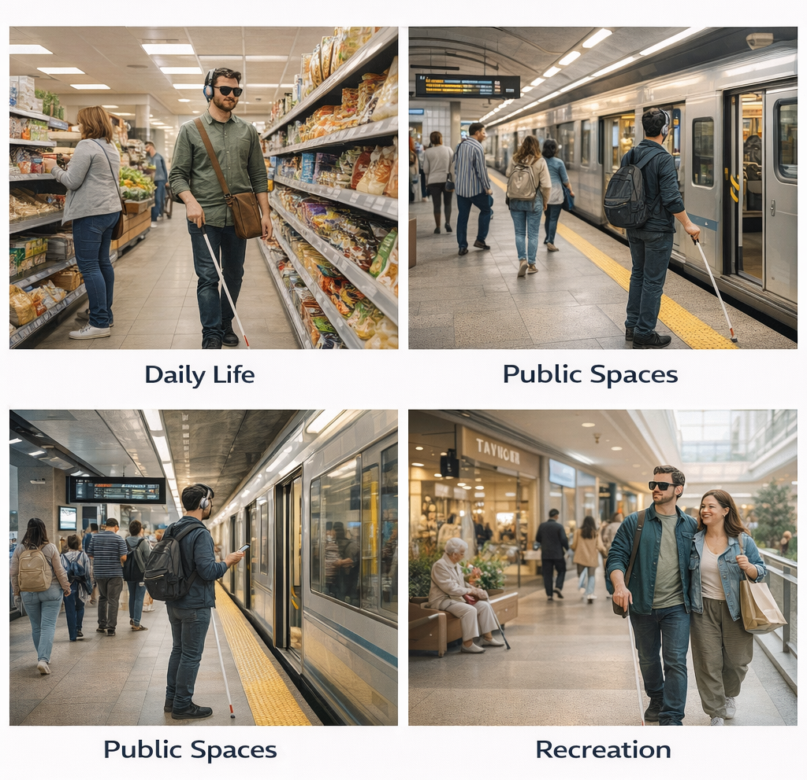
TARGET USERS & IMPACT
Scale or potential use cases:
>Daily life: Grocery stores, parks, residential streets, parking lots
>Public spaces: Bus stations, metro systems, airports, hospitals, government buildings
>Recreation: Shopping malls, restaurants, parks ,etc

Slide 11
FEASIBILITY & APPROACH
How the team plans to build it in 24 hours:
Hrs 0-6: Set up the Flutter app, get camera working, connect to Gemini Vision API, set up basic text-to-speech and vibration.
Hrs 6-14: Build the detection system—get Gemini analyzing scenes, add on-device object detection with TensorFlow Lite, make them work together to spot obstacles.
Hrs 14-20: Create the "brain"—write logic that turns detections into actual instructions like ‘move left’ or ‘stop’. Build the system that decides what's urgent and what can be ignored.
Hrs 20-24: Wire up audio and vibration feedback, test it walking around real spaces, fix bugs, record a demo video.
Backup plan: If Gemini integration is slow, we lean harder on local detection first. We're using pre-trained models so we don't waste time training AI. Modular code means team members can work in parallel.

Slide 12
FEASIBILITY & APPROACH
Tools / technologies (high-level):
>Flutter: Build the mobile app (works on both iOS and Android)
>Google Gemini Vision API: Understand scenes intelligently
>TensorFlow Lite: Fast on-device object detection
>Phone hardware: Camera, speakers, vibration motor , Lidar Sensor (if available)
>Pre-trained models: MobileNet or similar (already optimized for phones)

Slide 13
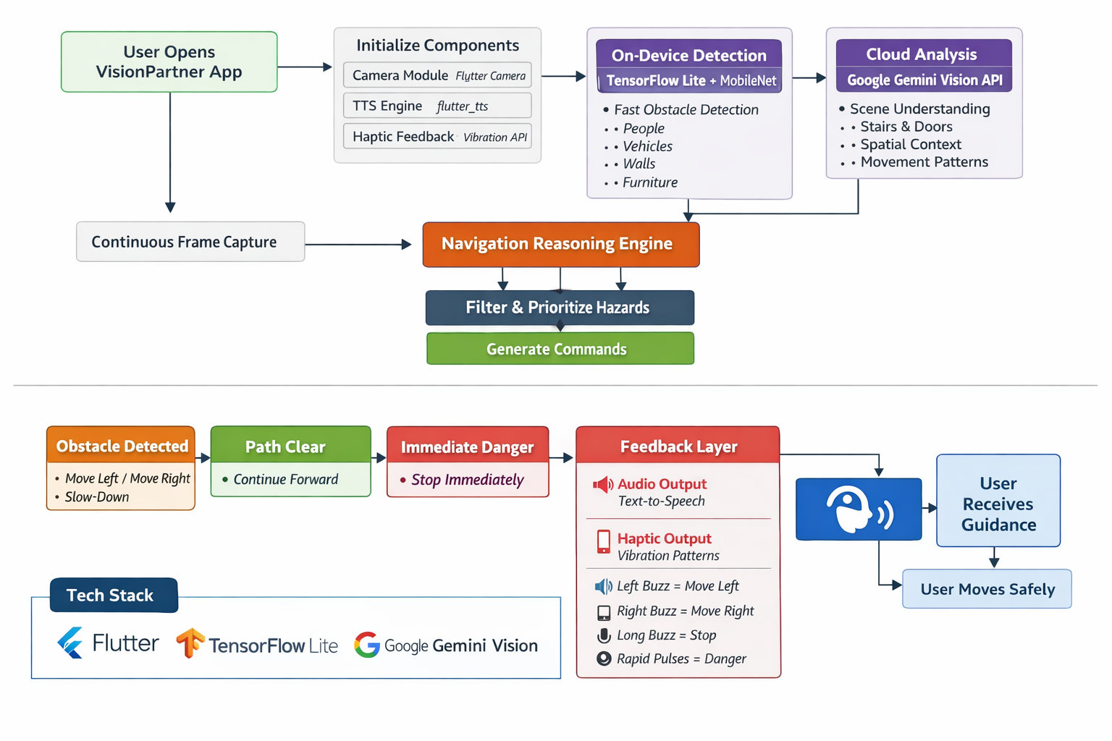
FEASIBILITY & APPROACH

Slide 14
FEASIBILITY & APPROACH
Key features planned for the hackathon:
Live camera analysis that continuously watches the environment
Smart obstacle detection—stairs, doors, people, vehicles, walls
Distance awareness—knowing how far away things are can be made more accurate with the help of Lidar sensor (if available)
Directional guidance—specific instructions like "shift right" or "stop now"
Audio instructions—clear spoken commands you can understand while moving
Vibration patterns—feel where to move without sound
Priority alerts—urgent dangers interrupt, less urgent things wait
Works offline—core detection doesn't need internet

Slide 15
COMPETITIVE ADVANTAGE
How your solution is better / different:
>The Real Game Changer: Independence Without Dependencies
Most solutions for blind navigation either require expensive specialized equipment, extensive training, or depend on things beyond the user's control. VisionPartner breaks that pattern—it's just you and your phone.
>No Waiting, No Training Period Guide dogs take 2+ years to train and cost upwards of $50,000. Even after getting one, you need months to bond and learn to work together. With VisionPartner, you download the app and start navigating in minutes. There's no certification process, no waiting lists, no complex setup.
>Works in the "Navigation Dead Zones" GPS apps are great on streets, but the moment you step into a building, parking garage, or underground station—they're useless. That's exactly where visually impaired people face the most anxiety. VisionPartner doesn't care if you're indoors or outdoors; if the camera can see it, we can guide you through it.

Slide 16
FUTURE SCOPE
Extensions beyond the hackathon / Long-term vision:
>We want VisionPartner to become more than an app—it should be a fundamental tool for independence that visually impaired people can rely on daily.
>also with the help of proper hardware we can make a device just for this without any internet or anything locally using cmaeras and lidar getting a 180° Degrees of view and proper audio
>Imagine someone deciding on a whim to visit someplace or just... going. No extensive planning, no arranging help, no anxiety. Just grabbing their phone and walking there confidently with VisionPartner guiding them.
>Long-term, we see this integrated into smart buildings and cities—when you enter a mall, VisionPartner automatically connects and helps you find stores. As AR glasses become normal, this becomes ambient intelligence that's just always there, barely noticeable but always protecting.
The ultimate goal: Make visual impairment a manageable challenge instead of a barrier to independence. Technology should enable freedom, not just provide information.

